Slide 1
Tutorial 3 Designing a Web Page with CSS

Slide 2
Objectives
Create a reset style sheet
Explore page layout designs
Center a block element
Create a floating element
Clear a floating layout
Explore grid-based layouts

Slide 3
Objectives (continued)
Create a layout grid
Format a grid
Explore the CSS grid styles
Explore positioning styles
Work with relative positioning
Work with absolute positioning
Work with overflow content

Slide 4
Overview of Grid-Based Layouts
Rows and columns form a grid
The number of rows is based on the page content
The number of columns is based on the number that provides the most flexibility in laying out the page content

Slide 5
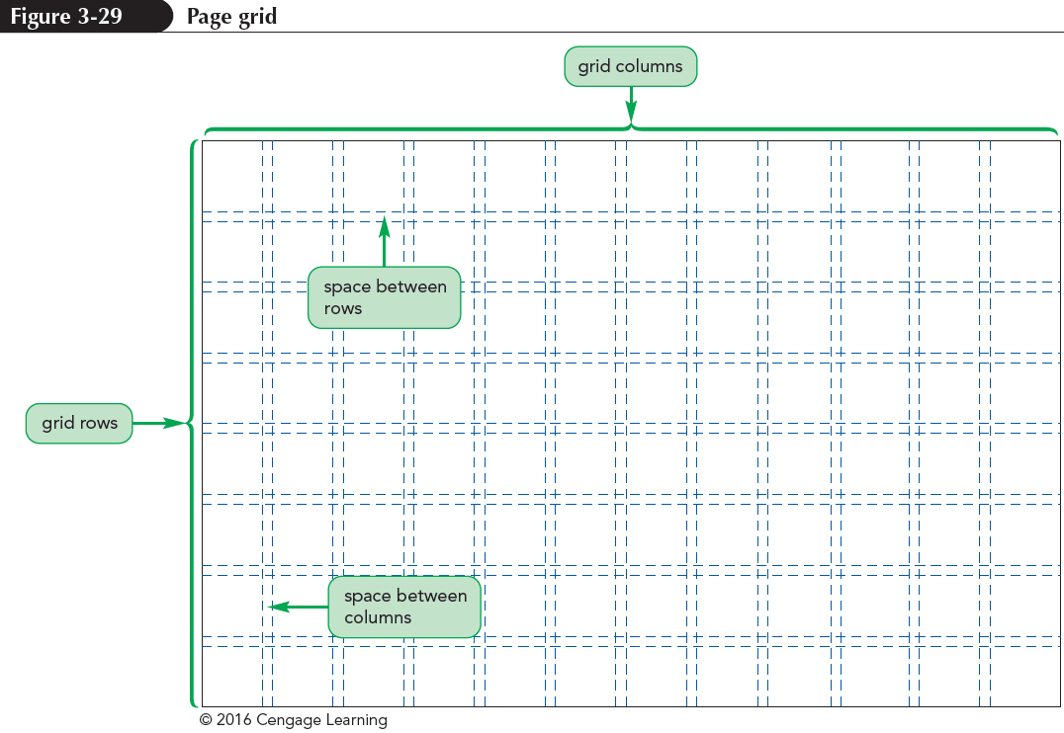
Overview of Grid-Based Layouts

Slide 6
Overview of Grid-Based Layouts
Advantages of using a grid:
Grids add order to the presentation of page content
A consistent logical design gives readers the confidence to find the information they seek
It is easily accessible for users with disabilities and special needs
It increases the development speed with a systematic framework for the page layout

Slide 7
Fixed and Fluid Grids
Fixed grids – Every column has a fixed position
Widths of the columns and margins are specified in pixels
Fluid grids – Provides more support across different devices with different screen sizes.
Column width is expressed in percentages

Slide 8
Setting up a Grid
A grid layout is based on rows of floating elements
Each floating element constitutes a column
The set of elements floating side-by-side establishes a row
Many grid layouts use the div (or division) element to mark distinct rows and columns of the grid

Slide 9
Setting up a Grid
This is an example of a simple grid consisting of a single row with two columns:
<div class=“row”>
<div class=“column1”></div>
<div class=“column2”></div>
</div>
The page content is placed within the div elements

Slide 10
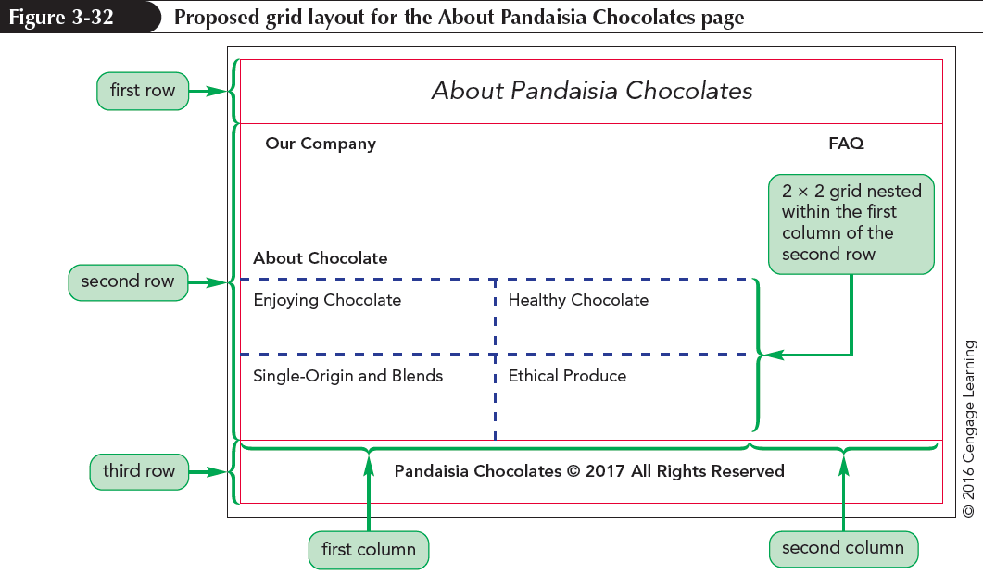
Setting up a Grid

Slide 11
Designing the Grid Rows
Grid rows contain floating columns
Since a grid row starts a new line within a page, it should only be displayed when both margins are clear of previously floated columns
div.row {
clear:both;
}

Slide 12
Designing the Grid Columns
Every grid column needs to be floated within its row
Grid columns are placed within a div element having the general class name
class=“col-numerator-denominator”
where numerator-denominator provides the fractional width of the column

Slide 13
Outlining a Grid
Outlines – Lines drawn around an element, enclosing the element content, padding, and border spaces
Outline-width: value; – Specifies the width of a line.
Properties of value are: thin, medium, or thick
Outline-color: color; – Specifies the color of a line.
Properties of color are: CSS color name or value

Slide 14
Outlining a Grid
Outline-style: style; – Specifies the design of a line
Properties of style are: solid, double, dotted, dashed, groove, inset, ridge, or outset
All of the outline styles properties can be combined into the outline shorthand property
Outline : width style color;

Slide 15
Defining a CSS Grid
To create a grid display without the use of div elements, use the following grid-based properties:
selector {
display: grid;
grid-template-rows: track-list;
grid-template-columns: track-list;
}
grid – Selected elements will be displayed as a grid
track-list – Space-separated list of row heights or column widths

Slide 16
Defining a CSS Grid (continued)
section
{
display: grid;
grid-template-rows: 100px auto 100px; grid-template-columns: 25% 50% 25%;
}

Slide 17
Defining a CSS Grid (continued)
fr unit – Represents the fraction of available space left on the grid after all other rows or columns have attained their maximum allowable size
For example, the following style creates four columns with the dimension specified in the style rule:
grid-template-columns: 200px 250px 1fr 2fr;

Slide 18
Assigning Content to Grid Cells
Elements in a CSS grid are placed within a grid cell at the intersection of a specified row and column
By default, all of the specified elements are placed in the grid cell located at the intersection of the first row and first column

Slide 19
Assigning Content to Grid Cells (continued)
To place an element in a different cell, use
grid-row-start: integer;
grid-row-end: integer;
grid-column-start: integer;
grid-column-end: integer;
where integer defines the starting and ending row or column that contains the content

Slide 20
Assigning Content to Grid Cells (continued)
aside
{
grid-row-start: 2;
grid-row-end: 3;
grid-column-start: 1;
grid-column-end: 2;
}

Slide 21
The CSS positioning Styles
To place an element at a specific position within its container, use
position: type;
top: value;
right: value;
bottom: value;
left: value;
where type indicates the kind of positioning applied to the element and top, right, bottom, and left properties indicate the coordinates of the element

Slide 22
The CSS Positioning Styles
Static positioning – The element is placed where it would have fallen naturally within the flow of the document
Relative positioning – The element is moved out of its normal position in the document flow
Absolute positioning – The element is placed at specific coordinates within containers

Slide 23
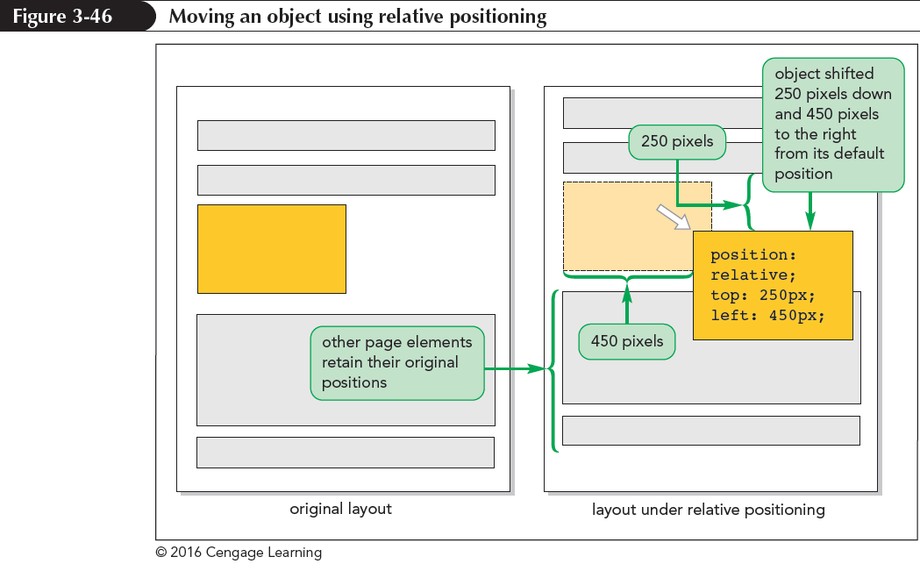
The CSS Positioning Styles

Slide 24
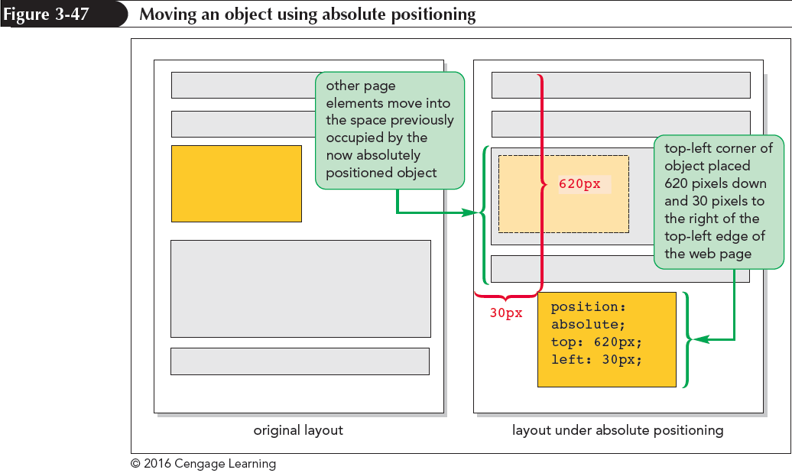
The CSS Positioning Styles

Slide 25
Fixed and Inherited Positioning
Fixed positioning – Fixes an object within a browser window to avoids its movement
footer { position : fixed; bottom : 10px; }
Inherited positioning – Allows an element to inherit the position value of its parent element

Slide 26
Handling Overflow
To specify how the browsers handle content that overflows the element’s boundaries
overflow: type;
where type is visible (the default), hidden, scroll, or auto
visible – Instructs browsers to increase the height of an element to fit overflow contents

Slide 27
Handling Overflow
hidden – Keeps an element at the specified height and width, but cuts off excess content
scroll – Keeps an element at the specified dimensions, but adds horizontal and vertical scroll bars
auto – Keeps an element at the specified size, adding scroll bars when they are needed

Slide 28
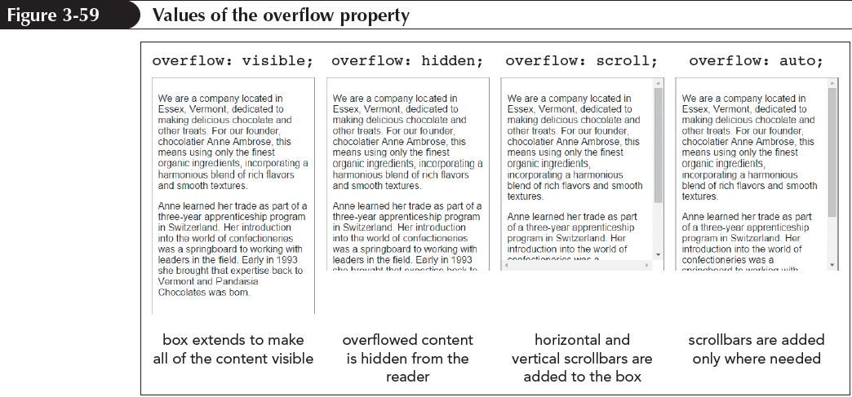
Handling Overflow
CSS3 provides the overflow-x and overflow-y properties to handle overflow specially in the horizontal and vertical directions

Slide 29
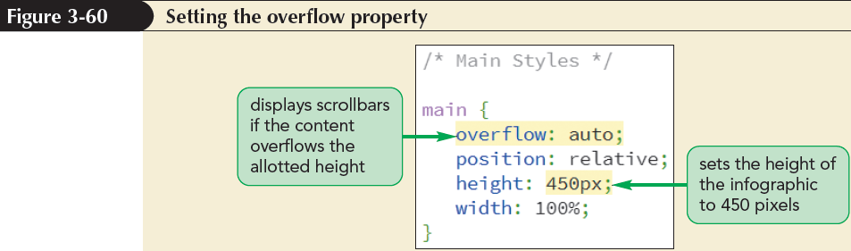
Handling Overflow

Slide 30
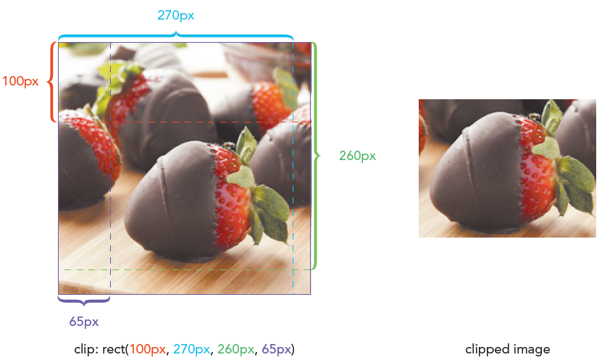
Clipping an Element
Clip – Defines a rectangular region where anything that lies outside of its boundary is hidden:
clip: rect(top, right, bottom,left);
where top, right, bottom, and left define the coordinates of the clipping rectangle

Slide 31
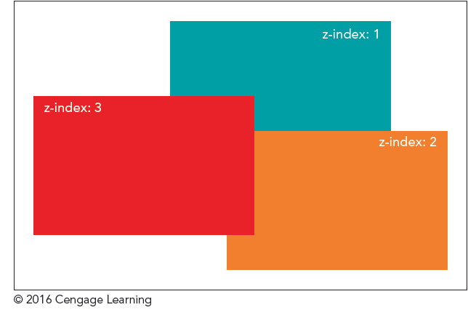
Stacking elements
To specify different stacking order, use:
z-index: value;
where value is a positive or negative integer, or the keyword auto
The z-index property works only for elements that are placed with absolute positioning
Notes:
By default, elements that are loaded later by a browser are displayed on top of elements that are loaded earlier

Slide 32
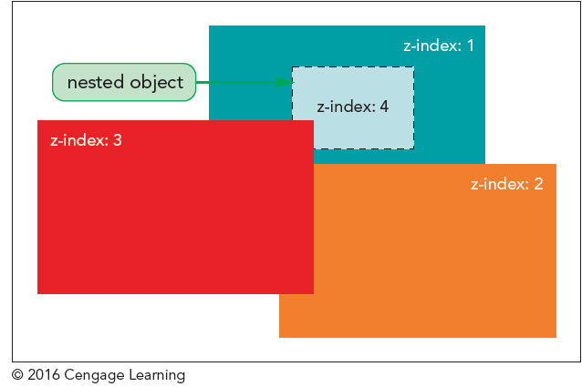
Stacking elements
An element’s z-index value determines its position relative only to other elements that share a common parent

